Slide 1
IBM Applied Data Science Capstone
Predicting MLB Team
Wins per Season
Landon Albritton

Slide 2
Why to predict the MLB Team Wins per Season?
Sporting events are deeply integrated in many people’s lives.
The highest level of play occurs in Major League Baseball (MLB), a professional league worth billions of dollars
Predicting the outcome of baseball games is an even more lucrative field.

Slide 3
Business Problem
Baseball itself is quite noisy and thus difficult to predict with high accuracy.
Any player having a “good” day can hit a home run, and this action alone can allow for a lesser-skilled team to defeat a better team.
Therefore, we explore machine learning algorithms using data from recent MLB seasons and try to predict the MLB Team Wins per Season is an ideal way.

Slide 4
Data Acquisition and Exploration
The data for this project came from the [Lahman database] (http://www.seanlahman.com/baseball-archive/statistics/), a respected record of historical baseball data.
It contains 2805 rows and 48 unique features.

Slide 5
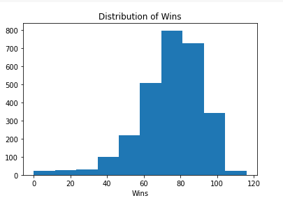
Distribution of Wins
Distribution of Wins
From above figure, we notice that the wins range from 0 to 120 and mean lies at around 74.740.

Slide 6
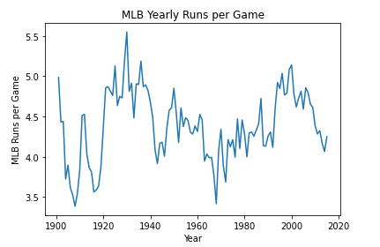
MLB Yearly Runs per Game

Slide 7
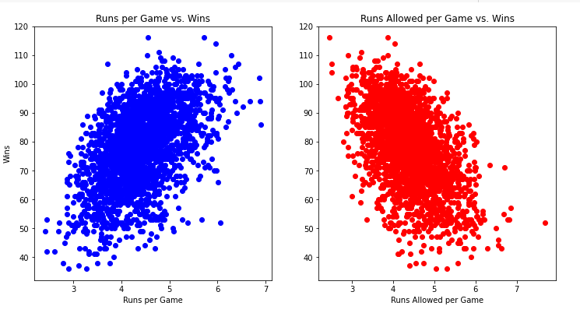
Scatterplot
Runs per Game is positively
correlated with Wins.
And, Runs Allowed per Game
is negatively correlated with Wins

Slide 8
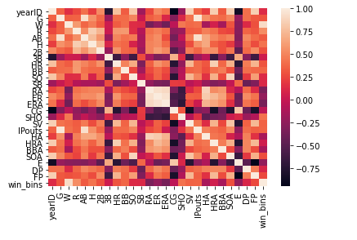
Finding Correlations
Column R and win_bins are
highly correlated with column W
with 0.59 and 0.91 correlation value
respectively

Slide 9
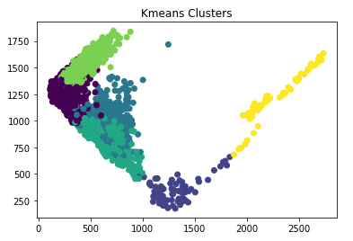
K-Means Clustering
Perform K-Means Clustering and
Find 6 as the optimal cluster value
Using Silhouette Score.

Slide 10
Machine Learning Models
The first model we train is a linear regression model.
We found out that the average number of wins was about 79 wins. On average, the model is off by only 2.687 wins.
Next, we try a Ridge regression model. The RidgeCV model allows us to set the alpha parameter, which is a complexity parameter that controls the amount of shrinkage. The model will use cross-validation to determine which of the alpha parameters out of (0.01, 0.1, 1.0, 10.0) is ideal.
This model performed slightly better, and is off by 2.673 wins, on average.

Slide 11
Discussion
For this project, the Ridge Regression Model give accurate results as such its off by only 2.687 wins.
We applied K-means algorithm to get optimal number of clusters but we notice that the cluster is not precise enough. Adding more hybrid features would be useful.

Slide 12
Conclusion
In this project, we used the data from Lahman database to predict the MLB Team wins per season.
From literature review, we first removed the irrelevant columns and further more removed the null values.
We train linear regression and Ridge Regression model. Ridge Regression produce an offset of 2.673 which outperforms the linear regression which produce the offset of 2.687.

Slide 13
References
Firsick, Z. 2013. “Predicting Major League Baseball Playoff Outcomes Through Multiple Linear Regression”. PhD thesis, University of South Dakota.
Kelleher, J. D., B. M. Namee, and A. D’Arcy. 2015. Fundamentals of machine learning for predictive data analytics: Algorithms, worked examples, and case studies. MIT Press, Cambridge, MA.

Slide 14
Thank You!!!

